Slide 1
Airplane Flight Controls
      Primary
      Ailerons
      Elevator
      Rudder
      Secondary
      Flaps, Leading Edge Devices, Spoilers
      Trim
      Moveable , Fixed

Slide 2
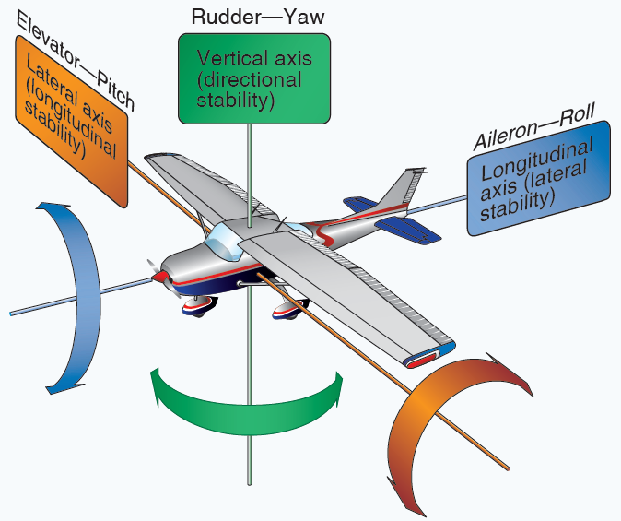
Movement about three axis of rotation

Slide 3
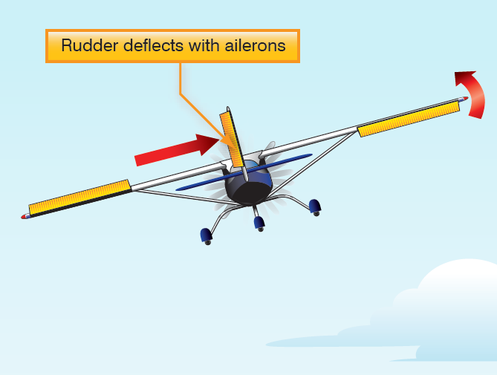

Ailerons control roll on the longitudinal axis

Slide 4
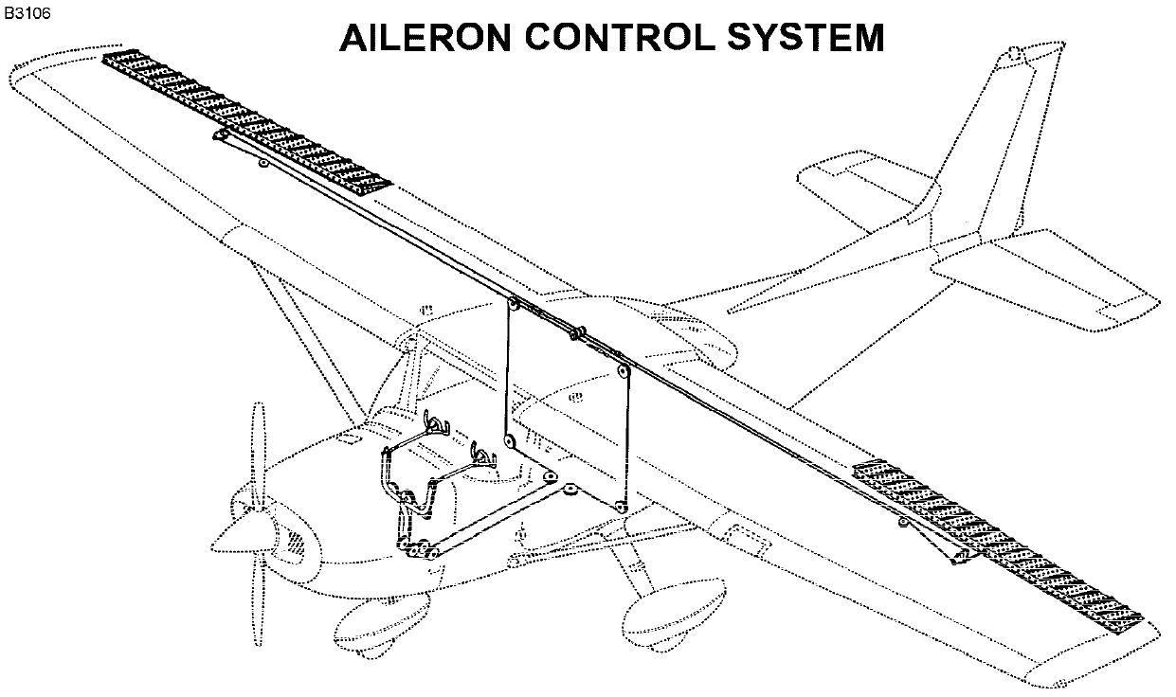
Ailerons control roll on the longitudinal axis

Slide 5
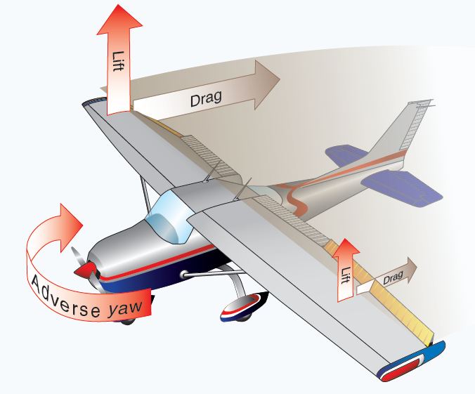
Movement of Ailerons creates Adverse Yaw

Slide 6
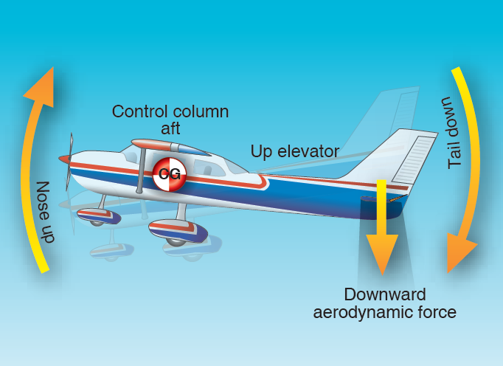
Elevator – controls pitch on the laterals axis

Slide 7
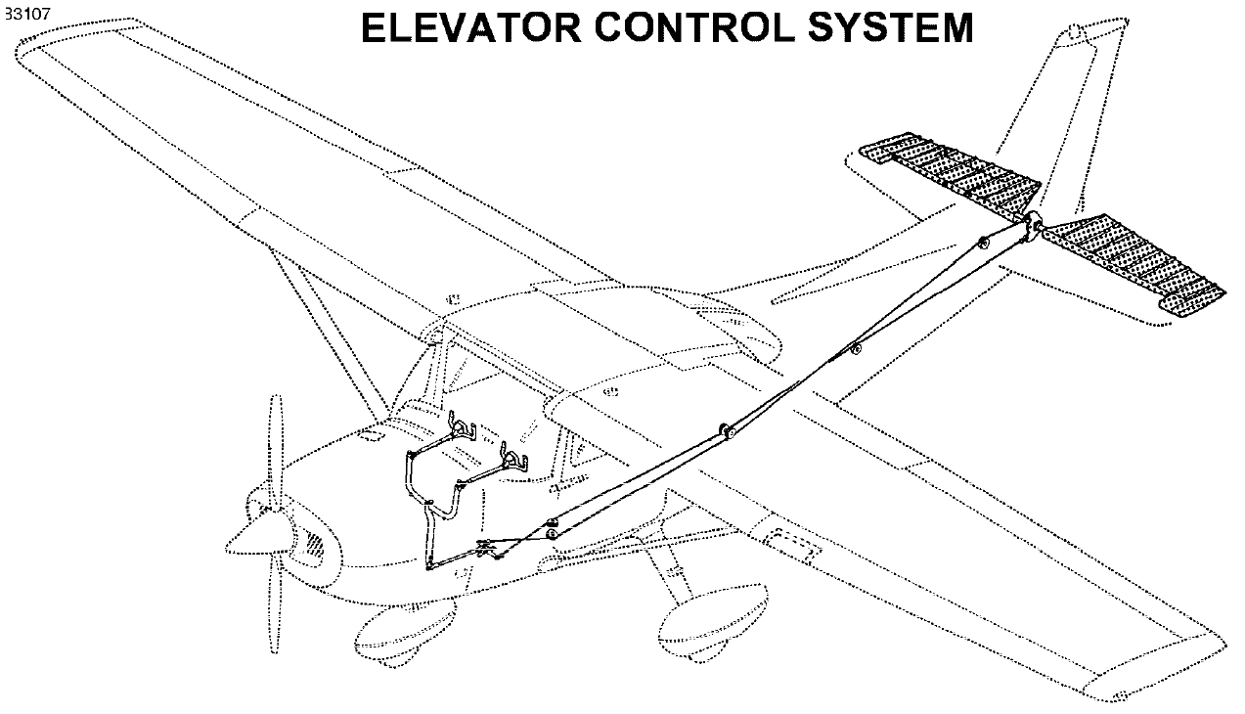
Elevator – controls pitch on the laterals axis

Slide 8
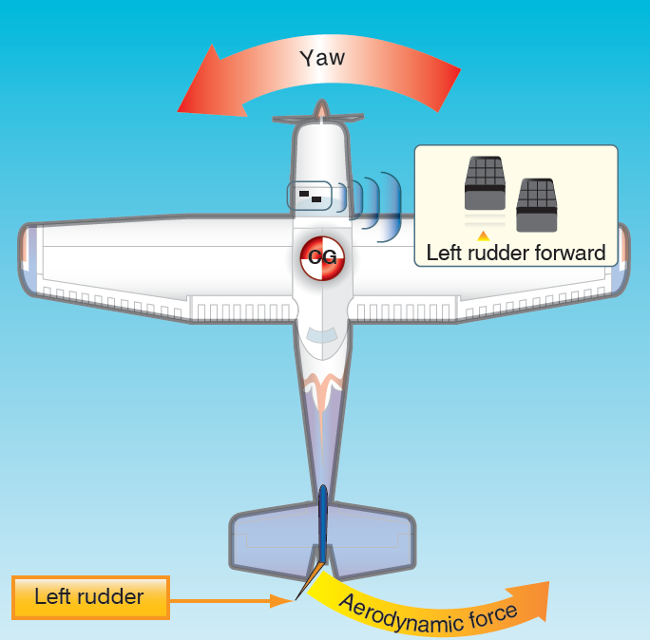
Rudder – controls yaw on the vertical

Slide 9
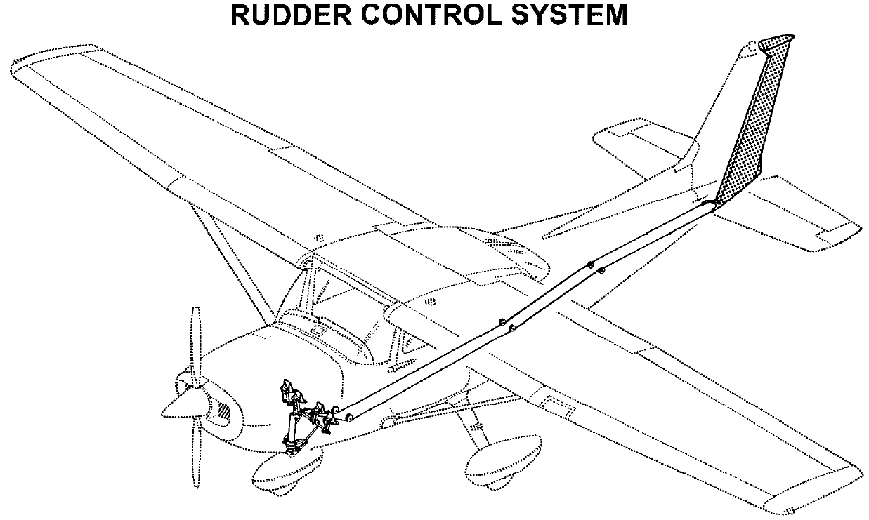
Rudder – controls yaw on the vertical

Slide 10
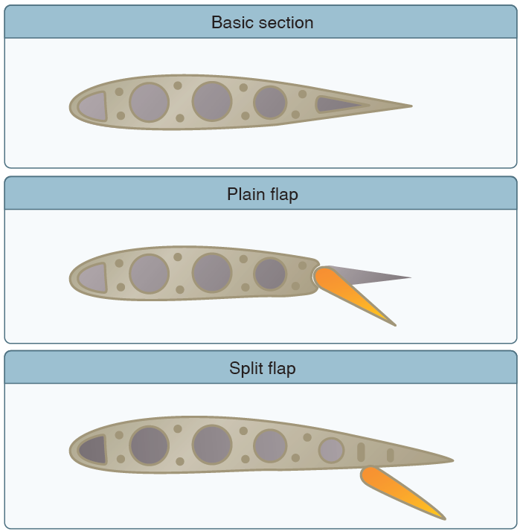
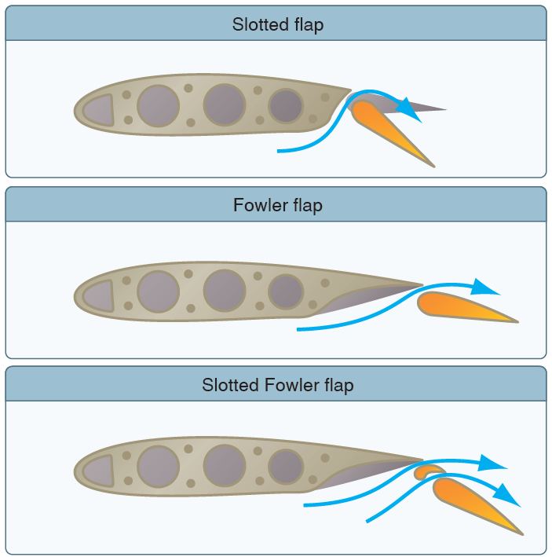
Secondary Controls – FLAPS
- Attached to the trailing edge of the wing, increase both lift & induced drag for any given AOA

Slide 11
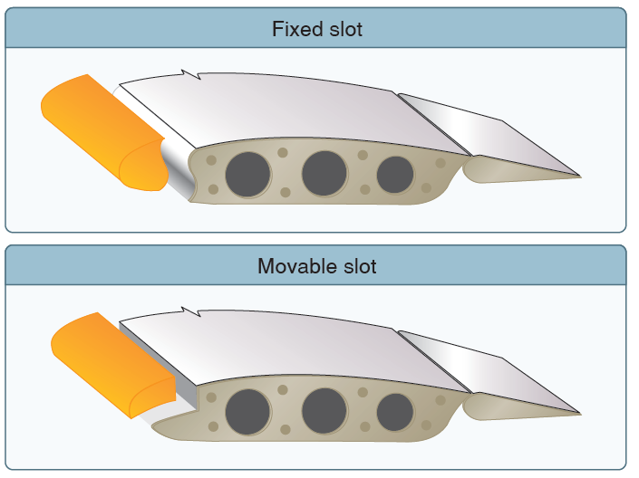
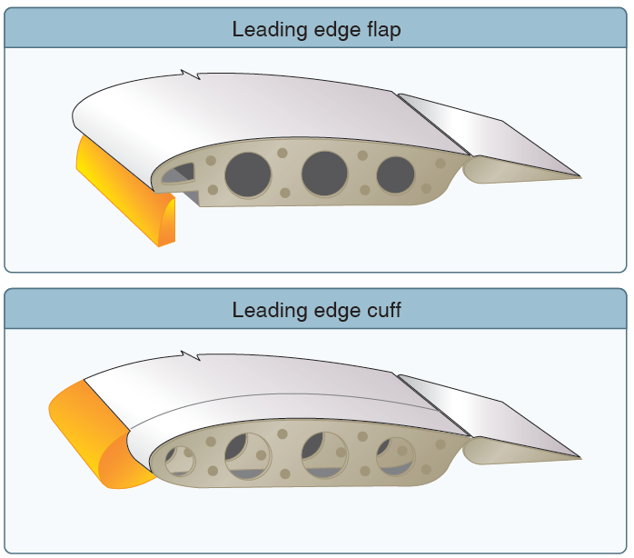
Secondary Controls – Leading Edge Devices
- Applied to the leading edge of the wing to direct airflow and/or increase camber of the wing

Slide 12
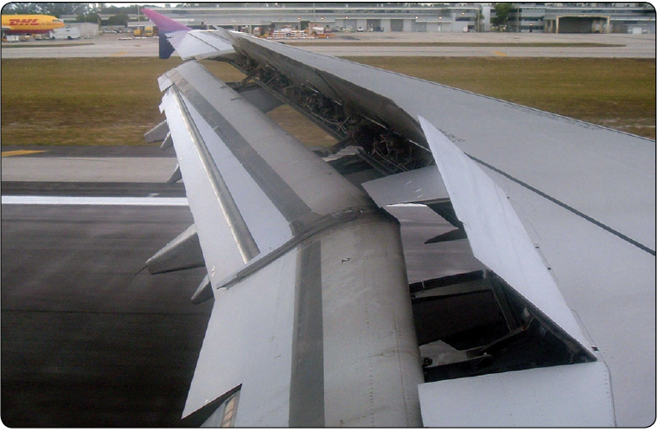
Secondary Controls – Spoilers
- High drag devices deployed from the wings to spoil smooth airflow, reducing lift and increasing drag

Slide 13
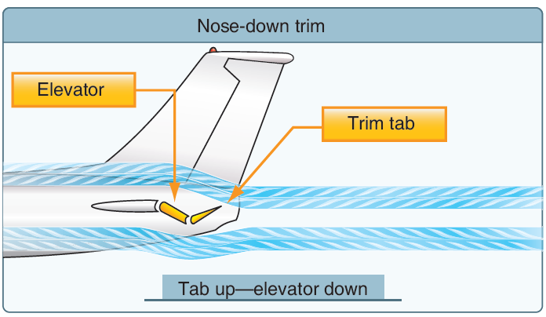
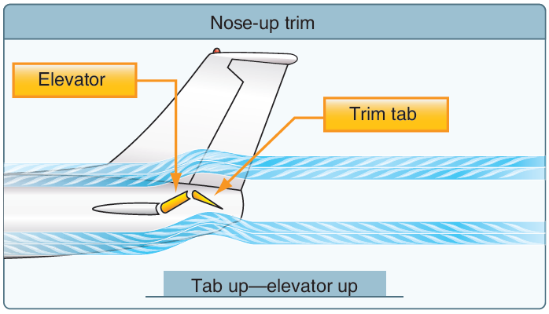
Trim Controls – Movable Trim Tab
- On small aircraft, attached to trailing edge of the elevator or rudder, manually operated

Slide 14
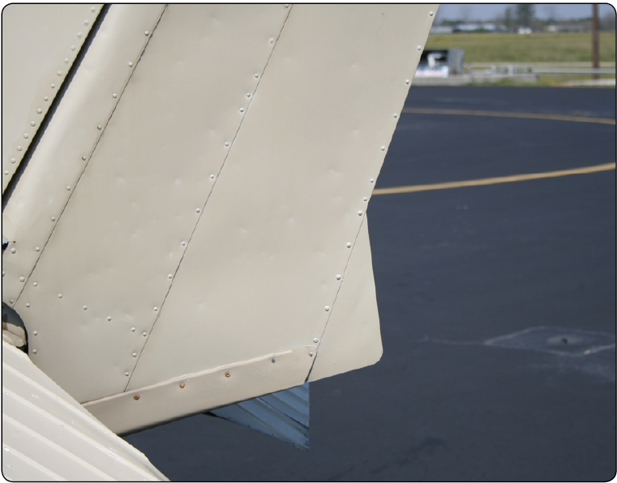
Trim Controls – Ground Adjustable Trim Tab
- On small aircraft, attached to trailing edge of the rudder, ground adjusted

